Slide 1
Covid Vaccine Data Warehouse
Jordan Clark, Tonderai Choto, and Jack DeVeney

Slide 2
Background
Global pandemic started November 2019
700 million confirmed cases, 7 million confirmed deaths
Vaccine was developed and released in December 2020
Since release of vaccine, there have been debates about adverse effects
Hard to find an answer without feeling it is bias

Slide 3
Questions
What is the distribution of outcomes for reported adverse events?
Are these adverse events comparable to regular rates of events prior to vaccine?
What is the distribution of facilities administering vaccines?
Which states had the most vaccinations on record?
What manufacturers produced the most vaccines?

Slide 4
VAERS
Got our data from https://vaers.hhs.gov/
Data shows vaccine, adverse effects and basic information about
People can go on the website and fill out survey
Must keep in mind this data is filled in voluntarily

Slide 5
Implementation Challenges
Large dataset
Null/Omitted values
Inconsistencies in frequency of testing in different states
Difficulty in aggregating data from different sources
Other causes that could lead to adverse effects not considered

Slide 6
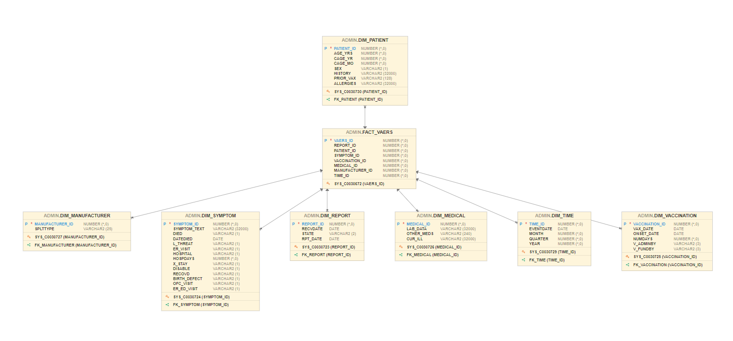
Schema
Notes:
Our dimension tables are Patients, Manufacturer, Symptom, Report, Medical, Time and Vaccination. The fact table includes our primary keys for the dimension tables and the VAERS_ID which was the primary key from the dataset.
Patients: Contains info about patients
Manufacturer: Is information about who manufactured the vaccines
Symptoms: Info about different symptoms, patient outcomes like death, life threatening , er visits, or if they recovered
Report: Is info about when when the forms were received by the organization and where the forms came from
Medical: Is information about medication, illnesses that a patient had before or diagnostic tests that were taken at the time of the vaccination
Vaccination: When the vaccination took place, what facility they took it at and how the vaccine was purchased.

Slide 7
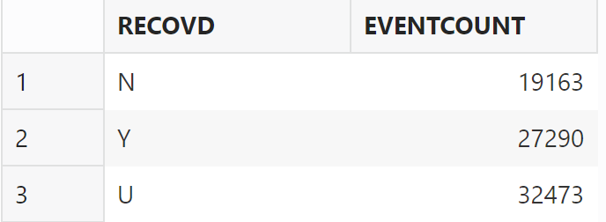
Distribution of Outcomes for Adverse Events
Notes:
Understanding the distribution of outcomes helps healthcare professionals and regulatory bodies assess the safety profile of vaccines or medical interventions. One thing we would like to end up doing is being able to connect this with vaccines to gauge how well each vaccines, but we need to do some more data cleaning to make that happen.

Slide 8
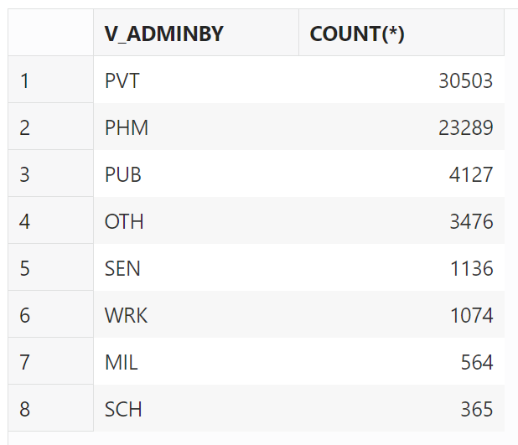
Distribution of facilities administering vaccines
Notes:
This is important to know for resource allocation because different may have different capacities and resources for vaccinations. Knowing this allows for distributors to know where the vaccines need to go. It is also a way to gauge where exactly people are going to get their vaccinations so we can direct more resources toward those facilities.
Key for facility type: PUB = Public (hospitals, health clinics), PVT = Private (urgent care centers, private hospitals, private medical practices), MIL = Military, PHM = Pharmacy or store, SCH = School or student health clinic, SEN = Nursing home or senior living facility, WRK = Workplace clinic, OTH = Other

Slide 9
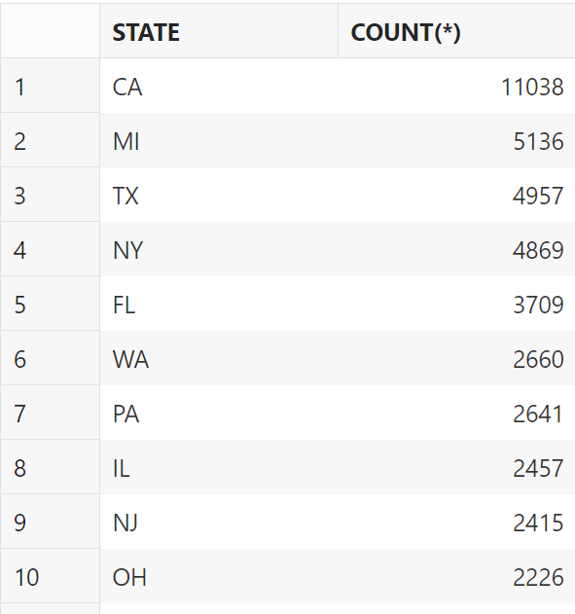
States with the Most Vaccinations Administered
Notes:
This is useful information because as you see with a state like California that has high population you want to be able allocate the vaccinations effectively. It also interesting to see because it allows health care officials to monitor the rates and track the spread of diseases and evaluate the effectiveness of the vaccinations.

Slide 10
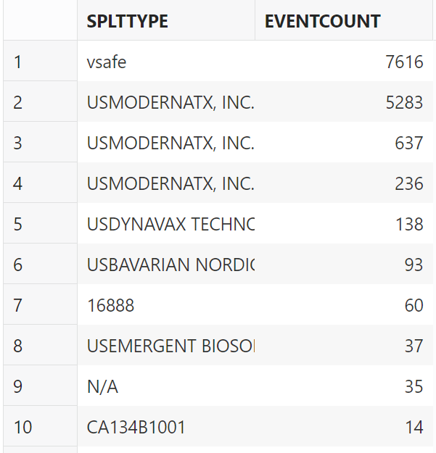
Top Manufacturers
Notes:
Understanding which manufacturer has produced the most vaccinations allows health authorities to monitor and ensure the quality and safety of the vaccines. Patterns in adverse events or other issues may be identified, leading to investigations or adjustments in vaccination strategies. It can also guide decisions on investments, partnerships, and future vaccine development strategies based on the performance and capabilities of different manufacturers. Finally, knowing which manufacturer has a significant presence in vaccine production allows health authorities to address public concerns, provide accurate information, and maintain trust in vaccination programs.

Slide 11
Conclusion
Exploration of covid-19 pandemic, vaccine development, distribution, and related adverse effects sheds light on the challenges faced by communities
Explore critical questions such as distribution of outcomes for reported adverse effects and how they compare to pre-vaccine rates.
The presence of null or omitted values in the dataset emphasized the need for comprehensive and standardized reporting systems.
The global vaccination effort has been a great achievement, however, it has highlighted the need to refine data collection and analysis methods.

